Slide 1

Darshan Rajeev Naik
naikdarshan221@gmail.com
JOHN CLOTHING'S ANNUAL SALES 2022 DATA ANALYSIS

Slide 2
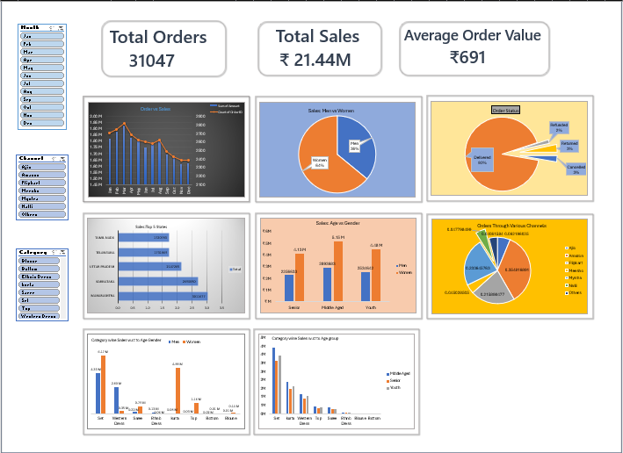

Slide 3
Darshan Rajeev Naik
naikdarshan221@gmail.com
SET
BOTTOM
KURTA
BLOUSE
WESTERN DRESS
ETHNIC DRESS
TOP
SAREE

Slide 4
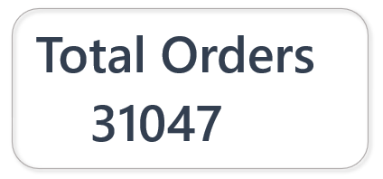
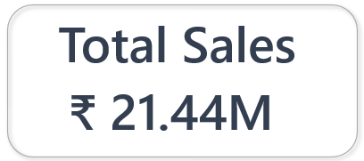
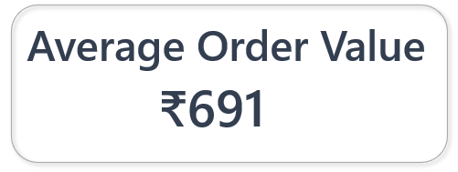
Darshan Rajeev Naik
naikdarshan221@gmail.com

Slide 5
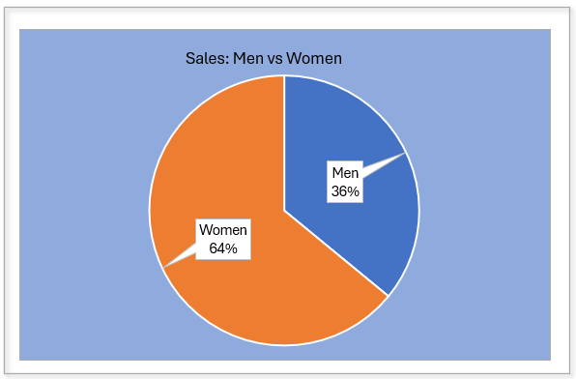
Darshan Rajeev Naik
naikdarshan221@gmail.com

Slide 6
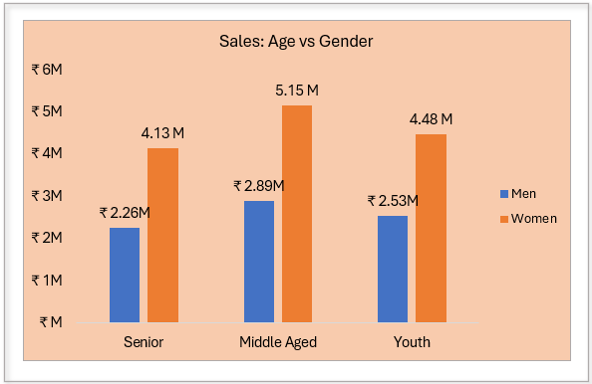
Darshan Rajeev Naik
naikdarshan221@gmail.com

Slide 7
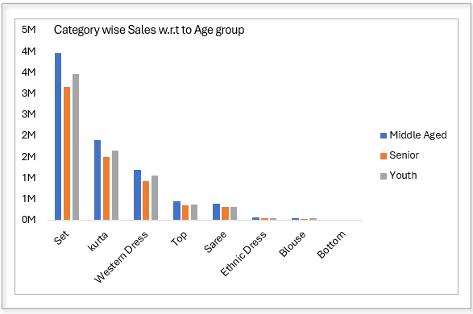

Slide 8
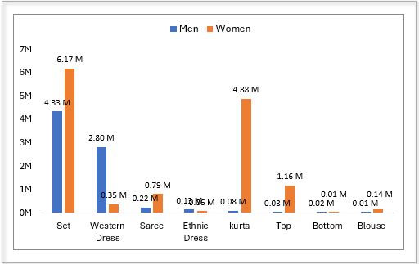

Slide 9
INSIGHTS:
Focus on Traditional Outfits:
Middle-aged customers(Women: 5.15M, Men:2.89M), especially women are the highest contributors. Thus, Marketing for traditional outfits should target this demographic using middle-aged models.
Youth-Oriented Western Outfits:
Youth(Women:4.48M, Men:2.53) are catching up with middle-aged customers in western outfits, Diversifying western styles can attract more youth.

Slide 10
Darshan Rajeev Naik
naikdarshan221@gmail.com
REGIONAL DISTRINUTION OF SALES

Slide 11
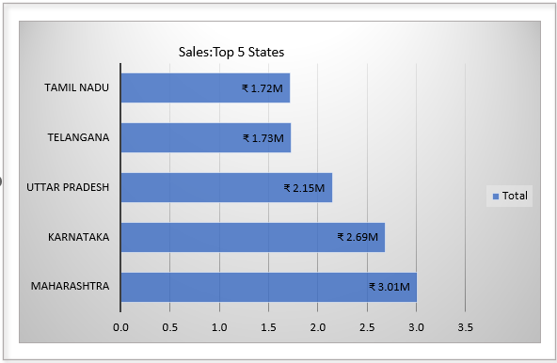

Slide 12
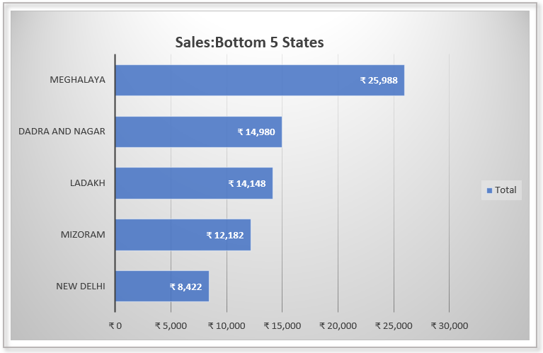

Slide 13
INSIGHTS:
In case of top 5 states:
Strengthen distribution networks and Inventory Management.
In case of bottom 5 states:
Hilly Areas, Difficulty in delivery, thus Physical store establishment with the essential products that the areas demand is a better option.

Slide 14
Darshan Rajeev Naik
naikdarshan221@gmail.com
ORDER STATUS AND DELIVERY CHANNELS

Slide 15
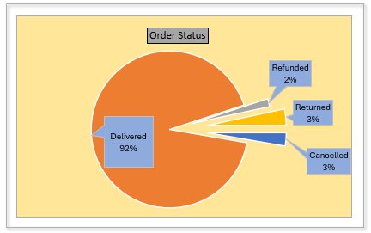
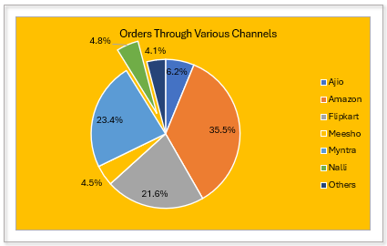
Order Status and Delivery Channels

Slide 16
INSIGHTS:
Delivery Channels:
Amazon, Myntra and Flipkart are our top 3 delivery partners thus having good relation with them ensure smooth transaction of business.
Order Status:
92% of orders are delivered where as 8% of orders either returned, cancelled or refunded and the issue lies in delivering wrong products, size issues.

Slide 17
Darshan Rajeev Naik
naikdarshan221@gmail.com
THANK YOU

